Slide 1

Chapter 3
Types and Patterns of Innovation
Strategic Management of Technological Innovation, 7th Edition
Melissa A. Schilling
© McGraw Hill LLC. All rights reserved. No reproduction or distribution without the prior written consent of McGraw Hill LLC.

Slide 2
Innovating in India: The Chotukool Project 1
In rural India up to 90% of families cannot afford appliances, have no electricity, and have no refrigeration.
Appliance manufacturer Godrej and Boyce decided to make a smaller, cheaper refrigerator to tap this market.
Many of their assumptions turned out to be wrong; they ended up making a lightweight portable battery operated refrigerator with customizable skins to make them cool and aspirational, and sold to multiple market segments, including the urban affluent.
Godrej and Boyce also pioneered a novel distribution system: the Chotukool would be sold at the post office.
Though it did not achieve wide adoption by the poor, it did help Godrej penetrate new market segments and demonstrated its innovative capabilities. It also won several design awards and FastCompany gave Godrej its “Most Innovative Company” award.

Slide 3
Innovating in India: The Chotukool Project 2
Discussion Questions:
What were the pros and cons of attempting to develop a refrigerator for India’s rural poor?
What product and process innovations did the Chotukool entail? Would you consider these incremental or radical? Architectural or component? Competence enhancing or competence destroying?
Did the Chotukool pose a threat of disrupting the traditional refrigerator market? Why or why not?
Is there anything you think Godrej should have done differently to penetrate the market of rural poor families in India?
What other products might the lessons Godrej learned with Chotukool apply to?

Slide 4
Overview
Several dimensions are used to categorize innovations.
These dimensions help clarify how different innovations offer different opportunities (and pose different demands) on producers, users, and regulators.
The path a technology follows through time is termed its technology trajectory.
Many consistent patterns have been observed in technology trajectories, helping us understand how technologies improve and are diffused.

Slide 5
Types of Innovation 1
Product versus Process Innovation.
Product innovations are embodied in the outputs of an organization – its goods or services.
Process innovations are innovations in the way an organization conducts its business, such as in techniques of producing or marketing goods or services.
Product innovations can enable process innovations and vice versa.
What is a product innovation for one organization might be a process innovation for another.
For example, U P S creates a new distribution service (product innovation) that enables its customers to distribute their goods more widely or more easily (process innovation).

Slide 6
Types of Innovation 2
Radical versus Incremental Innovation.
The radicalness of an innovation is the degree to which it is new and different from previously existing products and processes.
Incremental innovations may involve only a minor change from (or adjustment to) existing practices.
The radicalness of an innovation is relative; it may change over time or with respect to different observers.
For example, digital photography a more radical innovation for Kodak than for Sony.

Slide 7
Types of Innovation 3
Competence-Enhancing versus Competence-Destroying Innovation.
Competence-enhancing innovations build on the firm’s existing knowledge base.
For example, Intel’s Pentium 4 built on the technology for Pentium III.
Competence-destroying innovations renders a firm’s existing competencies obsolete.
For example, electronic calculators rendered Keuffel and Esser’s slide rule expertise obsolete.
Whether an innovation is competence enhancing or competence destroying depends on the perspective of a particular firm.

Slide 8
Types of Innovation 4
Architectural versus Component Innovation.
A component innovation (or modular innovation) entails changes to one or more components of a product system without significantly affecting the overall design.
For example, adding gel-filled material to a bicycle seat.
An architectural innovation entails changing the overall design of the system or the way components interact.
For example, transition from high-wheel bicycle to safety bicycle.
Most architectural innovations require changes in the underlying components also.

Slide 9
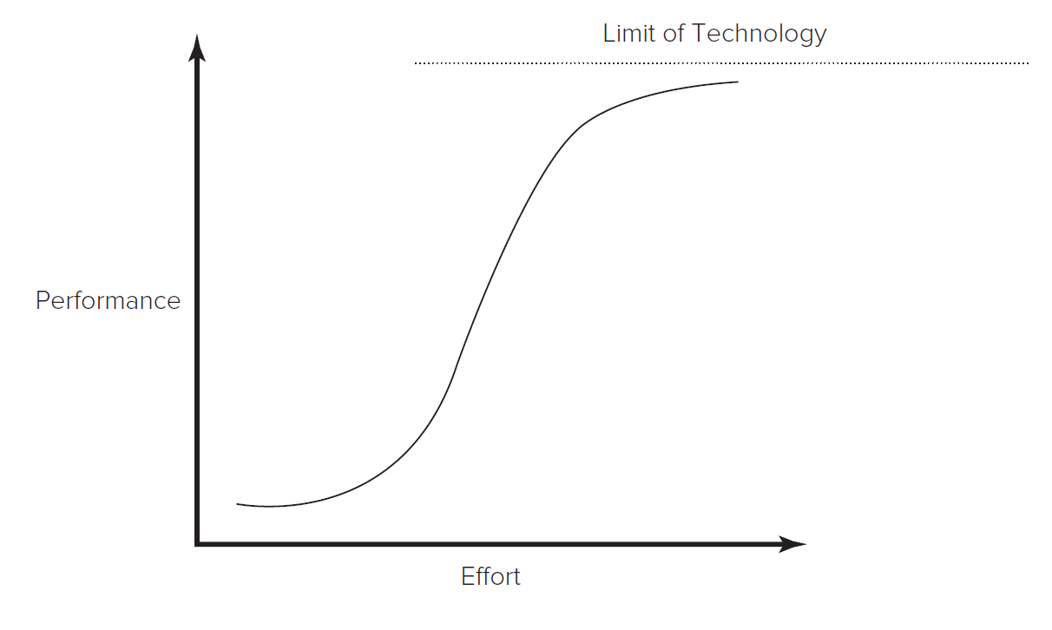
Technology S-Curves 1
Both the rate of a technology’s improvement, and its rate of diffusion to the market typically follow an s-shaped curve.
S-curves in Technological Improvement.
Technology improves slowly at first because it is poorly understood.
Then accelerates as understanding increases.
Then tapers off as approaches limits.
Access the text alternative for slide images

Slide 10
Technology S-Curves 2
Technologies do not always get to reach their limits.
May be displaced by new, discontinuous technology.
A discontinuous technology fulfills a similar market need by means of an entirely new knowledge base.
For example, switch from carbon copying to photocopying, or vinyl records to compact discs.
Technological discontinuity may initially have lower performance than incumbent technology.
For example, first automobiles were much slower than horse-drawn carriages.
Firms may be reluctant to adopt new technology because performance improvement is initially slow and costly, and they may have significant investment in incumbent technology.

Slide 11
Technology S-Curves 3
S-Curves in Technology Diffusion.
Adoption is initially slow because the technology is unfamiliar.
It accelerates as technology becomes better understood.
Eventually market is saturated and rate of new adoptions declines.
Technology diffusion tends to take far longer than information diffusion.
Technology may require acquiring complex knowledge or experience.
Technology may require complementary resources to make it valuable (for example, cameras not valuable without film).

Slide 12
Technology S-Curves 4
S-Curves as a Prescriptive Tool.
Managers can use data on investment and performance of their own technologies or data on overall industry investment and technology performance to map s-curve.
While mapping the technology’s s-curve is useful for gaining a deeper understanding of its rate of improvement or limits, its use as a prescriptive tool is limited.
True limits of technology may be unknown.
Shape of s-curve can be influenced by changes in the market, component technologies, or complementary technologies.
Firms that follow s-curve model too closely could end up switching technologies too soon or too late.

Slide 13
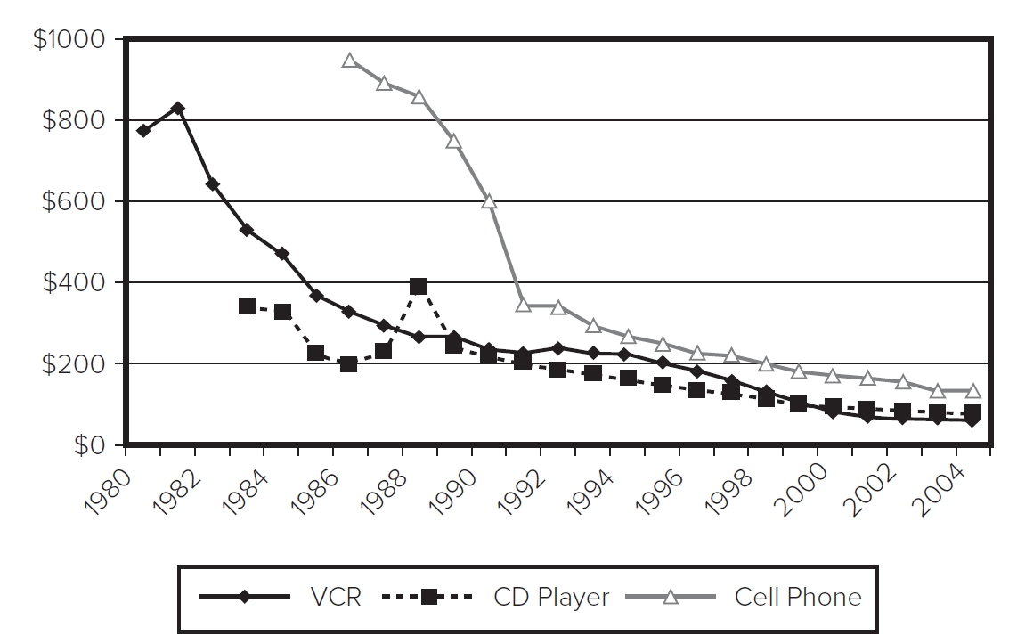
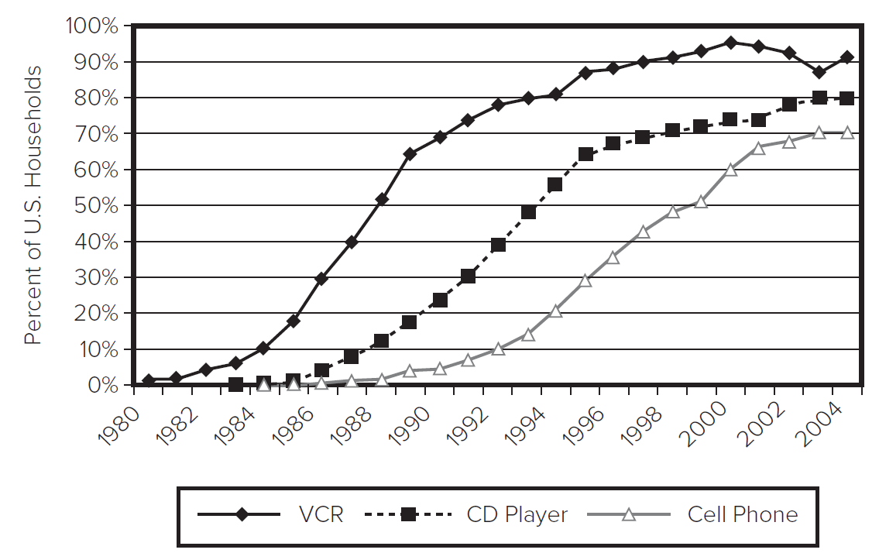
Technology S-Curves 5
S-curves of diffusion are in part a function of s-curves in technology improvement.
Learning curve leads to price drops, which accelerate diffusion.
Source: Consumer Electronics Association.
Source: Consumer Electronics Association.
Access the text alternative for slide images

Slide 14
Research Brief 1
Diffusion of Innovation and Adopter Categories.
Everett M. Rogers created a typology of adopters:
Innovators are the first 2.5% of individuals to adopt an innovation. They are adventurous, comfortable with a high degree of complexity and uncertainty, and typically have access to substantial financial resources.
Early Adopters are the next 13.5% to adopt the innovation. They are well integrated into their social system and have great potential for opinion leadership. Other potential adopters look to early adopters for information and advice, thus early adopters make excellent "missionaries" for new products or processes.
Early Majority are the next 34%. They adopt innovations slightly before the average member of a social system. They are typically not opinion leaders, but they interact frequently with their peers.
Late Majority are the next 34%. They approach innovation with a skeptical air and may not adopt the innovation until they feel pressure from their peers. They may have scarce resources.
Laggards are the last 16%. They base their decisions primarily on past experience and possess almost no opinion leadership. They are highly skeptical of innovations and innovators and must feel certain that a new innovation will not fail prior to adopting it.

Slide 15
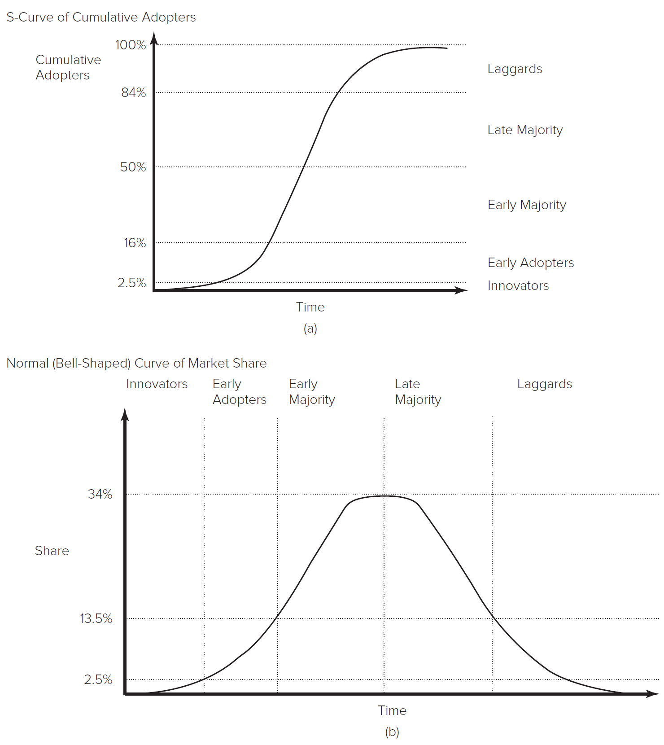
Research Brief 2
Diffusion of Innovation and Adopter Categories
Access the text alternative for slide images

Slide 16
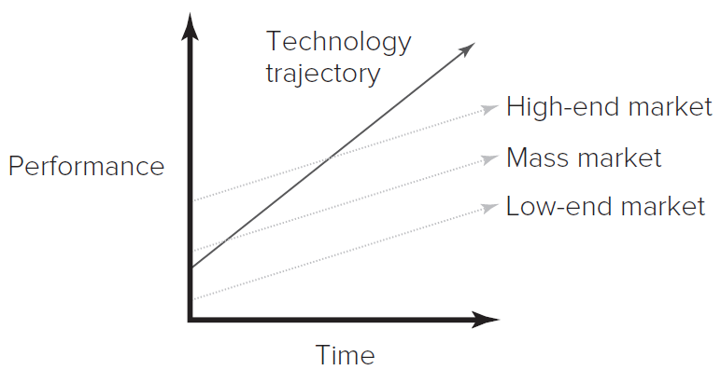
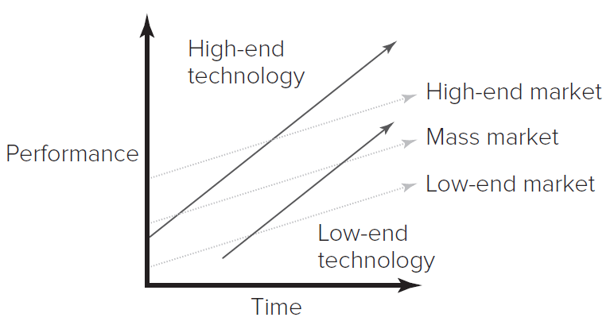
Theory In Action 1
“Segment Zero” – A serious threat to Microsoft?
Technologies often improve faster than customer requirements demand.
This enables low-end technologies to eventually meet the needs of the mass market.
Access the text alternative for slide images

Slide 17
Theory in Action 2
From 19 80 to 2011, Microsoft was the dominant personal computer operating system. However, operating systems for smartphones and tablets were improving to the point where they could replace many personal computer functions.
In 2015, Apple’s iPhone operating system and Google’s Android collectively controlled over 90% of the market for smartphone purchases. Microsoft’s Windows Phone held a share of only 3%.
As tablets based on these systems became fully functional computers, would Microsoft’s dominance evaporate?

Slide 18
Technology Cycles 1
Technological change tends to be cyclical:
Each new s-curve ushers in an initial period of turbulence, followed by rapid improvement, then diminishing returns, and ultimately is displaced by a new technological discontinuity.
Utterback and Abernathy characterized the technology cycle into two phases:
The fluid phase (when there is considerable uncertainty about the technology and its market; firms experiment with different product designs in this phase).
After a dominant design emerges, the specific phase begins (when firms focus on incremental improvements to the design and manufacturing efficiency).

Slide 19
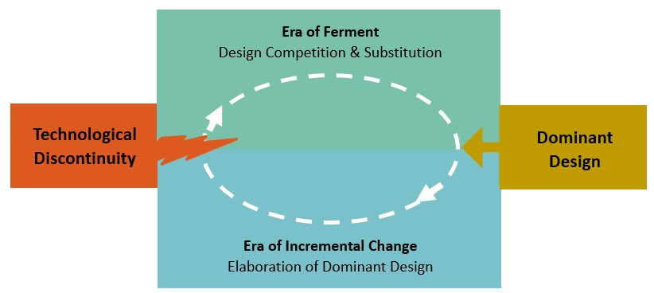
Technology Cycles 2
Anderson and Tushman also found that technological change proceeded cyclically.
Each discontinuity inaugurates a period of turbulence and uncertainty (era of ferment) until a dominant design is selected, ushering in an era of incremental change.
Access the text alternative for these images

Slide 20
Technology Cycles 3
Anderson and Tushman found that:
A dominant design always rose to command the majority of market share unless the next discontinuity arrived too early.
The dominant design was never in the same form as the original discontinuity but was also not on the leading edge of technology. It bundled the features that would meet the needs of the majority of the market.
During the era of incremental change, firms often cease to invest in learning about alternative designs and instead focus on developing competencies related to the dominant design.
This explains in part why incumbent firms may have difficulty recognizing and reacting to a discontinuous technology.

Slide 21
Discussion Questions
What are some of the reasons that established firms might resist the adoption of a new technology?
Are well-established firms or new entrants more likely to a) develop and/or b) adopt new technologies? What are some reasons for your choice?
Think of an example of an innovation you have studied at work or school. How would you characterize it on the dimensions described at the beginning of the chapter?
What are some of the reasons that both technology improvement and technology diffusion exhibit s-shaped curves?
Why do technologies often improve faster than customer requirements? What are the advantages and disadvantages to a firm of developing a technology beyond the current state of market needs.
In what industries would you expect to see particularly short or long technology cycles? What factors might influence the length of technology cycles in an industry?

Slide 22
Supplementary Video
A short video on:
Innovation Strategy: Patterns of Innovation
https://youtu.be/bvjvo6M2zRI

Slide 23
End of Main Content
© McGraw Hill LLC. All rights reserved. No reproduction or distribution without the prior written consent of McGraw Hill LLC.

Slide 24
Accessibility Content: Text Alternatives for Images

Slide 25
Technology S-Curves 1 – Text Alternative
Return to parent-slide containing images.
The x-axis of the graph represents effort. The y-axis of the graph represents performance. The graph is an s-curve with the plateau labeled limit of technology. When money and effort are invested, technology initially improves at a slow pace. With improvements, performance accelerates at an exponential rate. Performance reaches a plateau when technology begins to reach its inherent limits.
Return to parent-slide containing images.

Slide 26
Technology S-Curves 5 – Text Alternative 1
Return to parent-slide containing images.
(Figure 3.5) The x-axis represents years; its values range from 19 80 to 2004 at intervals of 2. The y-axis represents the average sales prices in dollars; its values range from 0 to 1000 at intervals of 200. The approximate data from the graph are as follows: For videocassette recorders, the average sales price was $780 in 19 80. It rose to $840 in 19 82 and decreased significantly until 19 89. Between 19 89 and 2004, the rate of decline was less. The average sales price in 2004 was $80. For compact disc players, the average sales price was $360 in 19 83. It decreased between 19 83 and 19 87 and rose to a price of $400 in 19 89. From 19 89 to 2004, it decreased steadily. In 2004, the average sales price was $100. For cell phones, the initial average sales price was $970 in 19 86. It decreased to $830 in 19 89. The rate of decline was significant from 19 89 to 19 91. The average sales price was $360 in 19 91. Between 19 91 and 2004, the rate of decline was less. In 2004, the average sales price was $120.
Advance to rest of text alternative

Slide 27
Technology S-Curves 5 – Text Alternative 2
Return to parent-slide containing images.
(Figure 3.6) The x-axis represents years; its values range from 19 80 to 2004 at intervals of 2. The y-axis represents percentage; its values range from 0 to 100 at intervals of 10. The approximate data from the graph are as follows: For videocassette recorders, household penetration was 1 percent in 19 80. It rose steadily between 19 80 and 2000. Household penetration was 97 percent in 2000 and decreased between 2000 and 2003. It then increased to 91 percent in 2004. For compact disc players, household penetration was 0 percent in 19 84. It increased steadily until 19 97. Household penetration was 68 percent in 19 97. Between 19 97 and 2004, the rate of increase was comparatively lower than the previous years. In 2004, household penetration was 80 percent. For cell phones, household penetration was 0 percent in 19 85. Between 19 85 and 19 88, it increased slightly. Household penetration was 1 percent in 19 88. It increased significantly between 19 88 and 2004. In 2004, household penetration was 70 percent.
Return to parent-slide containing images.

Slide 28
Research Brief 2 – Text Alternative 1
Return to parent-slide containing images.
The first graph is a labeled s-curve of cumulative adopters. In this graph, the x-axis represents time. The y-axis represents cumulative adopters; its values are as follows: 2.5 percent, 16 percent, 50 percent, 84 percent, and 100 percent. The diffusion s-curve is a line graph that starts near the origin of the graph, curves upward, and continues in an upward incline, after which it reaches a plateau. Lines extend from each marking of the y-axis, splitting the diffusion curve into five sections that correspond to Roger’s adopter categories. In the first section labeled innovators, the line graph extends from the point of origin. In the second section labeled early adopters, the line curves upward. In the third and fourth sections labeled early majority and late majority, respectively, the line continues steadily on an upward incline. In the fifth section labeled laggards, the line plateaus and travels parallel to the y-axis. The first section of the curve corresponds to the range of percentage values from 0 to 2.5. The second section of the curve corresponds to the range of percentage values from 2.5 to 16. The third section of the curve corresponds to percentage values from 16 to 50.
Advance to rest of text alternative

Slide 29
Research Brief 2 – Text Alternative 2
Return to parent-slide containing images.
The fourth section of the curve corresponds to percentage values from 50 to 84. The fifth section of the curve corresponds to percentage values from 84 to 100. The second graph is labeled normal (bell-shaped) curve of market share. In this graph, the x-axis represents time. The y-axis represents market share; its values are as follows: 2.5 percent, 13.5 percent, and 34 percent. There are lines extending from these markings that intersect the bell curve. There are five labels that pertain to Roger’s five categories at the top of the graph: innovators, early adopters, early majority, later majority, and laggards. These labels are arranged parallel to the y-axis. Lines extend from each of these labels to form a grid along with the lines extending from the y-axis. The section of the bell curve that extends from the origin corresponds to the category innovators and pertains to the percentage values between 0 and 2.5. The section of the curve that inclines upward is labeled early adopters and pertains to percentage values between 2.5 and 13.5.
Advance to rest of text alternative

Slide 30
Research Brief 2 – Text Alternative 3
Return to parent-slide containing images.
The section of the curve that progresses in a steady incline and reaches a plateau is labeled early majority and pertains to percentage values between 13.5 and 34. The section of the curve that progresses from the plateau in a steady decline is labeled late majority and pertains to percentage values between 34 and 13.5. The section of the curve where the rate of decline decreases and the bell curve meets the x-axis is labeled laggards.
Return to parent-slide containing images.

Slide 31
Theory In Action 1 – Text Alternative
Return to parent-slide containing images.
The x-axis represents time, and the y-axis represents performance. Three parallel lines extend from the y-axis and progress in a steady incline, representing increasing customer demands in the high-end market, the mass market, and the low-end market. The performance expectations are high in the high-end market, low in the low-end market, and moderate in the mass market. Another line extending from the y-axis just below the beginning of the mass market performance expectations progresses at a significantly higher trajectory, illustrating that the performance of technologies offered by companies to the market exceeds the expectations of customers over time.
The x-axis represents time, and the y-axis represents performance. Three parallel lines extend from the y-axis and progress in a steady incline, representing increasing customer demands in the high-end market, the mass market, and the low-end market. There are two more lines, one extending from the y-axis and another extending from a point away from both axes. Both lines have a slope greater than those of the other lines in the graph. The first line represents high-end technology. This line intersects the lines pertaining to the demands of the high-end market and the mass market at specific points. The second line is labeled low-end technology. This line intersects the lines pertaining to the demands of the mass market and the low-end market at specific points. The graph illustrates that as time progresses, technologies exceed the requirements of the low-end market much more than mass markets and high-end markets do.
Return to parent-slide containing images.

Slide 32
Technology Cycles 2 – Text Alternative
Return to parent-slide containing images.
The technological cycle comprises two eras, each of which is triggered by an event. The era of ferment is triggered by technological discontinuity. It is characterized by companies competing to create the best design and substitution. The era of ferment ends with the rise of a dominant design. This triggers the beginning of the era of incremental change, which is characterized by the elaboration of the dominant design. This era continues until the next technological discontinuity begins another era of ferment, and so on.
Return to parent-slide containing images.

